Slide 1

GenAI for
Programming
Edgar Galindo
Hector Triana

Slide 2
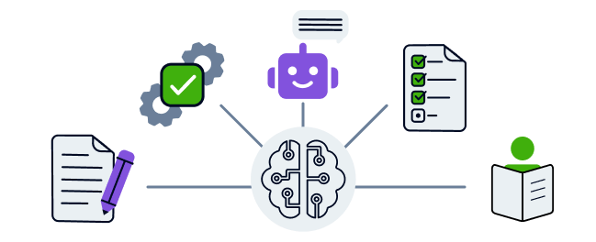
Foundations of Generative AI
Generative AI refers to AI systems capable of generating new data, such as images, text, or code, based on the patterns learned from a training set. Generative models are trained using large datasets to learn relationships and patterns in data. These models typically rely on deep learning, a subset of machine learning using neural networks with multiple layers.
Types of Generative Models: Common models include Generative Adversarial Networks (GANs), Variational Autoencoders (VAEs), and autoregressive models like GPT (used for generating text/code).

Slide 3
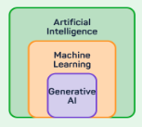
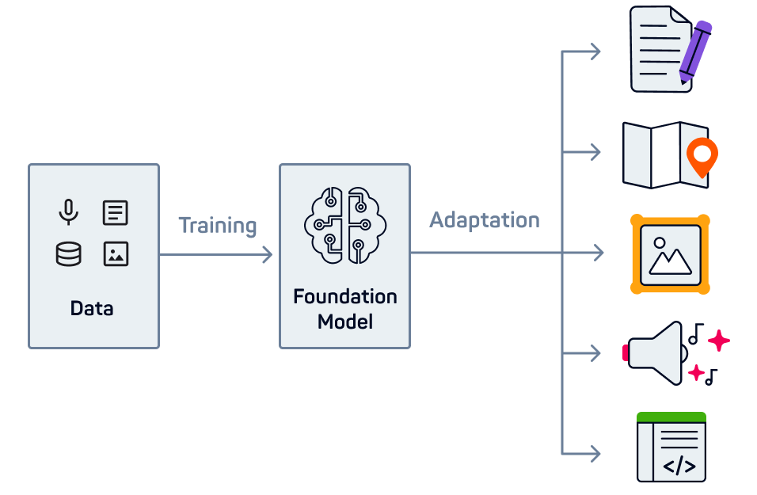
How Generative AI Works
Generative AI is trained on a large corpus of data (e.g., text, code) to learn statistical relationships. These models predict the next token (word or code element) based on the preceding sequence.
Key Components:
Corpus: A large dataset (in coding, a dataset of code snippets, documentation, etc.).
LLM (Large Language Model): A type of model that leverages vast corpora to generate human-like text or code.
Tokens: The basic units (words, characters) that the model predicts one at a time.

Slide 4
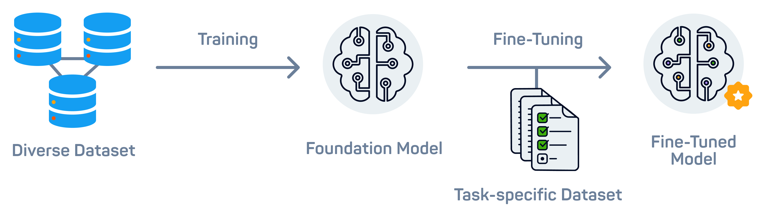
An LLM is trained in different phases. In phase one, it's trained on a vast and diverse corpus of unlabelled text data, to learn patterns and structures (Supervised Learning). Once an LLM has been trained to be able to predict the next word, it then gets trained with labeled conversations, to learn to follow human instructions and perform new tasks (Supervised Learning). At the core of GenAI are its foundation models. They are very versatile ML models that can be used in various applications for a wide range of tasks.
Foundation models are trained on generic and diverse data. They are generalists, good at many tasks.
Fine-tuning is the process of further training a generic foundation model with more specific data, so that it becomes more skilled at certain tasks.

Slide 5

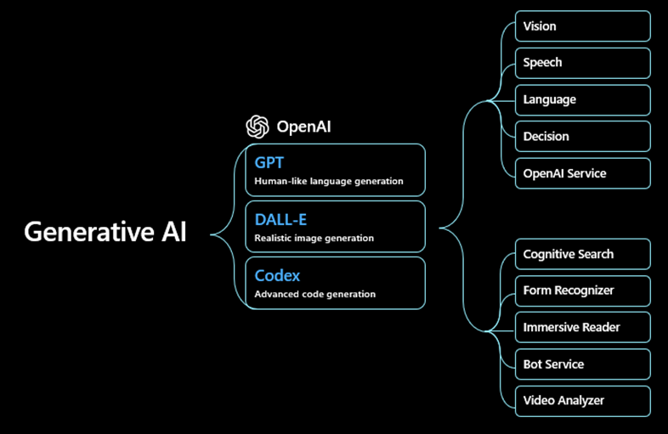
Key Terms and Their Relations
Large Language Models (LLMs): These are AI models, such as GPT-3, GPT-4, Codex, etc., that generate text, including code, by learning from massive corpora of data.
Reinforcement Learning from Human Feedback (RLHF): A fine-tuning process where models receive human feedback and adjust their behavior to generate more accurate and ethical results.
Corpus: The dataset used for training the model, which for coding LLMs, typically includes open-source repositories, StackOverflow Q&A, and programming documentation.
Inference and Generation: The model generates code or text by making inferences based on the input provided, and outputs a sequence based on prior knowledge learned from the corpus.

Slide 6
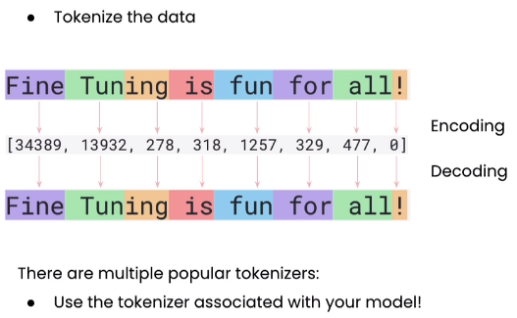
Token: represents a piece of the input text or code used by the model during the prompting process. Tokens can be as small as a single character, a word, or a subword. The process of breaking down text into tokens is called tokenization.
In relation to an LLM (Large Language Model), the model processes and generates outputs by analyzing and predicting tokens based on the prompt provided. Each token is part of the model's input/output, with the number of tokens affecting both performance and response length.
Token Limitations in LLMs:
Each model has a limit on how many tokens it can process in one interaction (both for input and output combined). For example:
GPT-3 might support around 4,096 tokens.
GPT-4 might support even more, with options for 8,000 to 32,000 tokens.
This means that when writing prompts or generating long-form text, it's essential to manage the token count carefully.

Slide 7
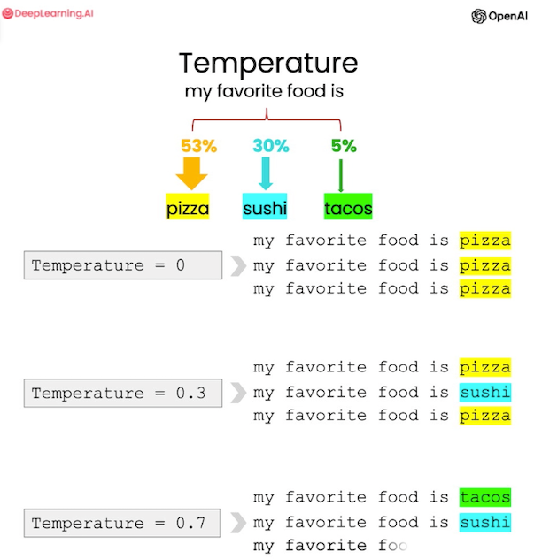
Tokenization: The model breaks down the input and output text into tokens for processing.
Temperature: This is a parameter that controls the randomness of the model’s token predictions.
High Temperature (e.g., 1.0 or above): The model generates more diverse, less predictable tokens. This may result in creative but less deterministic outputs.
Low Temperature (e.g., 0.1): The model focuses on higher-probability token choices, producing more deterministic and predictable outputs.
Example:
Low Temperature: The model may stick to very likely, standard token choices (e.g., common programming solutions).
High Temperature: The model might explore less common tokens, generating more unique or varied responses (potentially more creative or surprising solutions).

Slide 8



Criteria for Choosing AI Models:
Code Accuracy: How often does the AI generate syntactically correct and functional code?
Language Support: Does the model support the specific programming languages you need (e.g., Python, JavaScript, etc.)?
Context Handling: How well does the model handle longer or more complex code snippets and contexts?
Speed and Efficiency: How fast does the model generate responses, especially for more complex problems?
User Customizability: Can the model be fine-tuned or adjusted to meet specific needs or frameworks?
OpenAI Codex (GPT-4)
Google's Gemini
Anthropic’s Claude

Slide 9
Programming Exercises Using LLMs
Easy Exercise: Print Fibonacci Sequence
Task: Write a javascript function to print the Fibonacci sequence up to n terms.
Medium Exercise: Build a Simple Calculator
Task: Write a program with html, css and javascript that works as a standard calculator and returns the result of arithmetic operations correctly
Hard Exercise: Implement a Simple AI Tic-Tac-Toe Game
Task: Write using html, css and javascript a Tic-Tac-Toe game that allows an AI plays against a user.
Proposal Exercises:
Task: Build a recursive problem for solving Hanoi's Towers (use any prog. language)
Task: Build a web-based Tetris game using basic web technologies (HTML, CSS, and JavaScript).

Slide 10
Proposal Links
https://kms-technology.com/emerging-technologies/ai/how-to-choose-a-generative-ai-model.html
https://www.britannica.com/technology/Google-Gemini
Gemini vs Palm
https://leaddev.com/tech/11-generative-ai-programming-tools-developers
https://www.oracle.com/sa/artificial-intelligence/generative-ai/generative-ai-software-development/
https://www.hopsworks.ai/dictionary/llm-temperature

Slide 11


